Slide 1

VirtuTeach AI
AI Teaching Simulator
Practice Teaching. Get Real-time AI Feedback. Improve Faster.
TEAM: ERROR 404 CODERS NOT FOUND
Notes:
1

Slide 2


The Problem — and Our Solution
The Gap in Teacher Training
VirtuTeach AI Bridges the Gap
New teachers have no safe space to practise and make mistakes
Traditional training gives zero real-time feedback on teaching quality
Every practice session requires real students — costly and impractical
A virtual classroom with AI student personas that react authentically
Real-time scoring across Clarity, Completeness & Engagement (1–10)
Voice & text input with PDF material upload for alignment tracking
Instant feedback via speech bubbles and emojis — just like a real class
Notes:
2

Slide 3




Key Features Implemented
AI Student Personas
Voice Recognition
3 unique students — Rahul, Ananya & Arjun — powered by Google Gemini API, each with distinct confusion and curiosity behaviours.
Web Speech API enables continuous real-time listening, letting teachers speak naturally without interruption.
PDF Processing
Real-time Scoring
PDF.js extracts keywords and tracks how well the teacher's speech aligns with uploaded lesson material.
Live scores (1–10) for Clarity, Completeness, and Engagement, plus a 0–100% material alignment meter.
Notes:
3

Slide 4
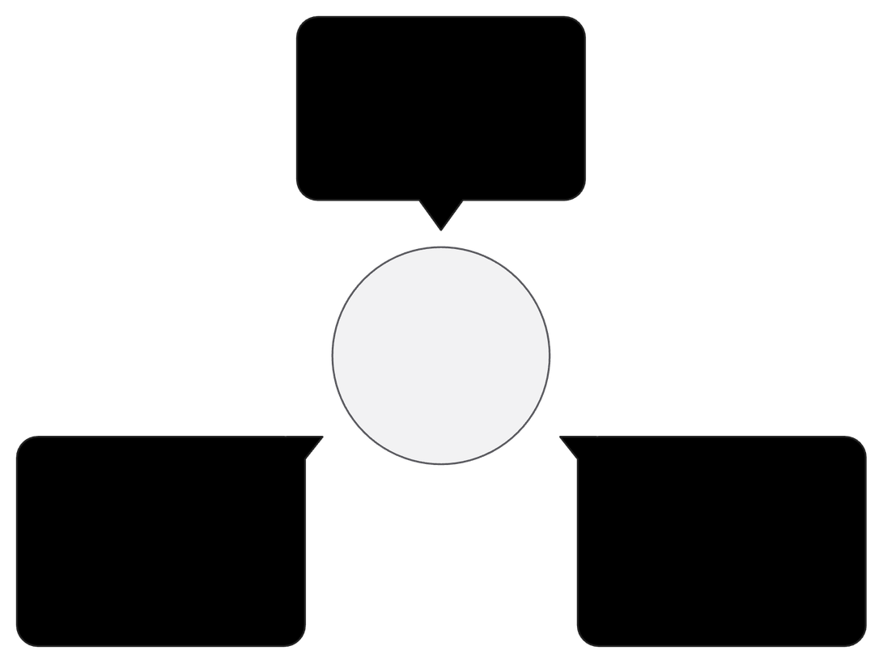
Technical Architecture
Stack at a Glance
Frontend: UI & I/O
HTML/CSS/JS handles voice and text
Frontend
Backend
HTML5 · CSS3 · JavaScript · PDF.js · Web Speech API · Chart.js
Node.js · Express.js handling the /analyze endpoint
Three-layer Architecture
AI: Gemini Evaluation
Backend: /analyze
AI Engine
gemini-2.5-flash-lite rates teaching & reactions
Node.js + Express routes POST and returns scores
Gemini 2.5 Flash Lite — fast, lightweight, and highly capable
Notes:
4

Slide 5
Demo Flow & Scoring System
User Journey
Scoring Rubric
01
Score
Meaning
Visual
Login → Upload PDF (optional) → Start Lecture
80–100
Excellent
🌟 Green
02
60–79
Good
👍 Yellow
Speak or type your teaching explanation
40–59
Needs Work
📈 Orange
03
<40
Beginner
📚 Red
AI analyses → Students react with bubbles & emojis
Single-button lecture control, live PDF alignment meter, and a Judge Dashboard with real-time charts make the experience seamless for both teachers and evaluators.
04
Alignment meter updates live as you teach
05
End Lecture → View comprehensive feedback report
Notes:
5

Slide 6

Impact & Future Roadmap
Why It Matters
What's Next
Democratises teacher training — practise anytime, anywhere
Reduces dependency on real students for skill development
Delivers objective, data-driven feedback at every session
🌐 Multi-language Support
👥 Collaborative Classrooms
📊 Advanced Analytics Dashboard
🔗 LMS Integration
Built in a hackathon. Ready for the classroom. Thank you from Team Error 404 Coders Not Found!
Notes:
6

